Slide 1
Designing in Stainless Steel
PUREST: Promotion of new Eurocode rules for structural stainless steels
RFCS Dissemination Project 709600

Slide 2
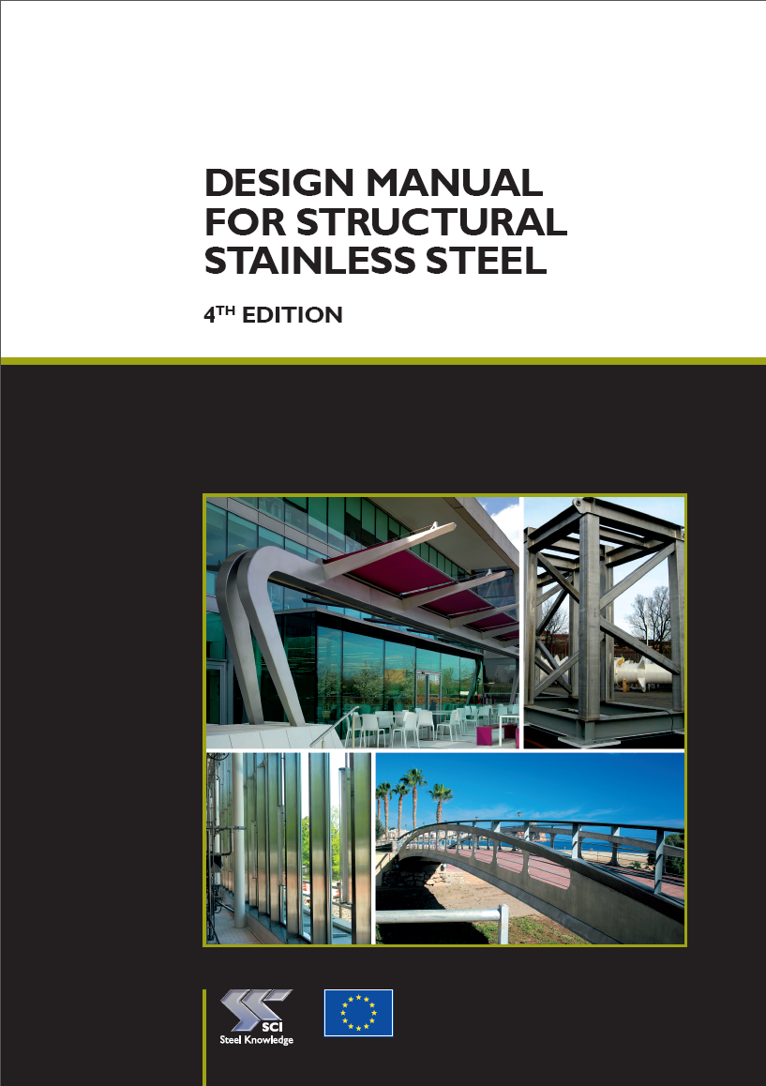
Design Manual for Structural Stainless Steel
Recommendations
Design Examples
Commentary
Software and apps
All PUREST deliverables in all languages are available for free download here:
www.steel-stainless.org/designmanual

Slide 3
Contents
The goal of this presentation is to give you a brief overview of the key facts about stainless steel along with (new) important design rules.
In terms of design approaches, the comparison with carbon steel is made.
For a more complete overview of design rules please download the Design Manual.

Slide 4
Contents
What is stainless steel?
Grades and Grade Selection Procedure
Properties of Stainless Steel
Stainless Steel Design Rules
Strength enhancement of cold formed sections
Continuous strength method (CSM)

Slide 5
What is Stainless Steel?
PUREST

Slide 6
What is Stainless Steel?
Stainless steel is a corrosion-resistant iron alloys that contains a minimum of 10.5% chromium (Cr).
Other present alloying elements:
carbon (C),
nickel (Ni),
manganese (Mn),
molybdenum (Mo),
copper (Cu),
silicon (Si),
sulphur (S),
phosphorus (P),
nitrogen (N).

Slide 7
What is Stainless Steel?
Families of stainless steel
Austenitic
Duplex
Ferritic
Precipitation Hardening
Martensitic
There are three main stainless steel grades interesting for structural design: austenitic, duplex and ferritic
Group | Strength | Ductility | Magnetic | Weldable | Formability
Austenitic |  |  |  | 
Duplex |  |  |  | 
Ferritic |  |  |  | ()

Slide 8
Chemical Composition of Stainless Steel
Martensitic
Ferritic
Austenitic
Duplex
Mo,
Mn,
Si,
Al,
Cu…
0-1,5 %
0- 4,5 %
0- 7 %
0- 4 %
11,5-17%
10,5-30%
3,5 - 8%
6 - 26%
21 - 26%
Ni
>0,1 %
<0,1 %
16 - 21%
Cr
<0,1 %
<0,1 %
C
Fe

Slide 9
Why use Stainless Steel?
Corrosion resistance and long life
Maintenance and inspection is difficult
Attractive metallic surface
Hygienic properties
Non-magnetic properties
Good toughness at very low temperatures

Slide 10
Passive Film
The natural formation of a passive surface film is the key to the corrosion resistance of stainless steels.
Properties of the passive film:
Chromium Rich Oxide
Very thin, ~ 20-30 Ångströms (2-3 nm)
Extremely adherent
Passive
Self Repairing (within minutes)

Slide 11
Passive Layer vs Coatings
Oxy-hydroxides of Fe and Cr
2-3 nm (0,002-0,003 µm)
PASSIVE FILM
STAINLESS STEEL
Topcoat
Primer
Typically
20-200 µm
MULTI-LAYER COATINGS
Pre-treatment
MILD STEEL

Slide 12
Passive Layer vs Coatings
Stainless Steel
Mild Steel
Passive film
Multi-layer Coating
Self Repair
Corrosion Products

Slide 13
Effect of Chromium Content on Atmospheric Corrosion Resistance
Corrosion rate
mmpy
0.200
0.175
0.150
0.125
0.100
0.075
Stainless steel
> 10.5 Cr %
0.050
0.025
0
2
4
6
8
10
12
14
16
% Chromium

Slide 14
Successful Applications
PUREST

Slide 15

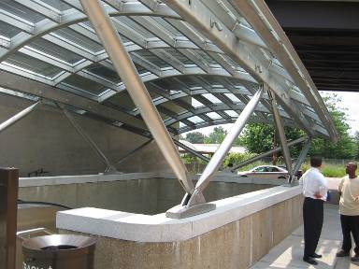
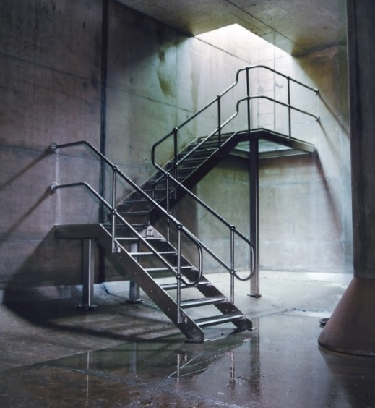
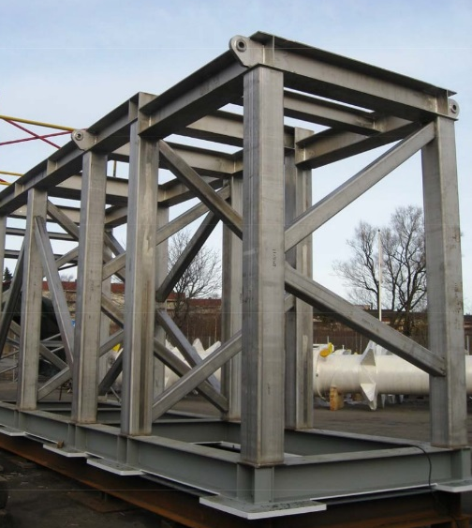
Successful Applications
Structural member
The Gap
Western Australia
© David Iles
Skid for offshore regasification plant © Montanstahl
Structural member Washington DC © Graham Gedge
Industrial structures Access walkways and ladders © Ancon Building Products

Slide 16
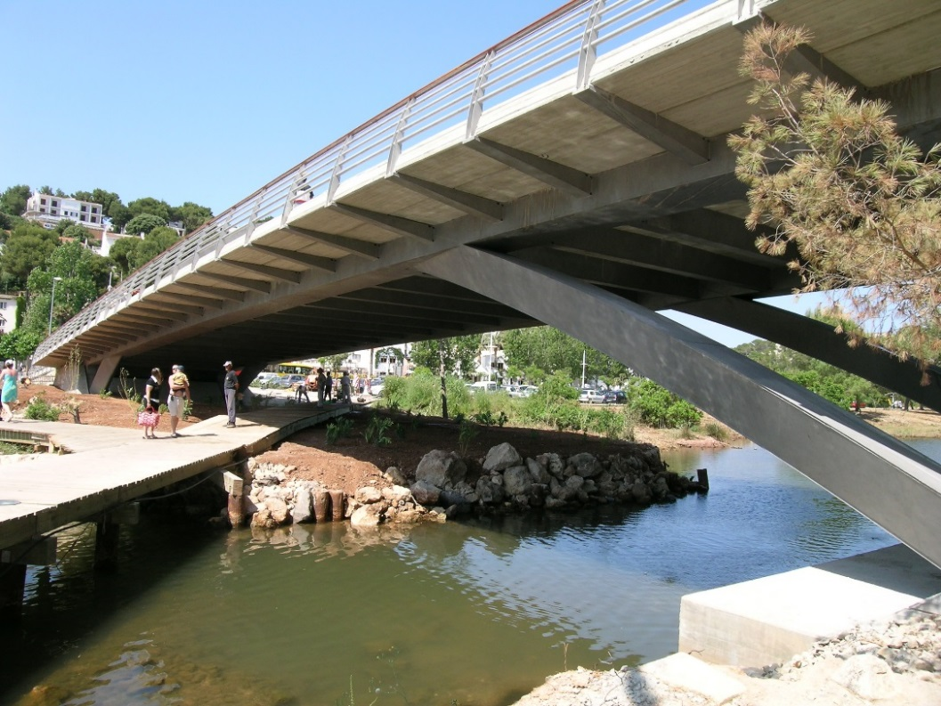

Successful Applications
Bridge Cala Galdana Bridge, Menorca © Pedelta
Bridge Helix Bridge, Singapore © IMOA

Slide 17


Successful Applications
Sculpture Houston arches
© Catherine Houska
Sculpture Cloud Gate, Chicago © Catherine Houska

Slide 18
Grades and Grade Selection Procedure
PUREST

Slide 19
Grades
The designation systems adopted in EN 10088 are the European steel number and a steel name. For example, grade 304L has a steel number 1.4307, where:
The groups of stainless steel are denoted in EN 10027-2 as:
1.40XX: Stainless steel with Ni < 2,5 % without Mo, Nb and Ti
1.41XX: Stainless steel with Ni < 2,5 % and Mo but without Nb and Ti
1.43XX: Stainless steel with Ni ≥ 2,5 % but without Mo, Nb and Ti
1.44XX: Stainless steel with Ni ≥ 2,5 %, and Mo but without Nb and Ti
1.45XX: Stainless steels with special additions
1.46XX: Chemical resistant and high temperature Ni grades
1. | 43 | 07
Denotes steel | Denotes one group of stainless steels | Individual grade identification

Slide 20
Grade Selection Procedure
A procedure for selecting the appropriate austenitic and duplex stainless steel grades for their application in certain environments, can be found in EN 1993-1-4/A1. Method is only valid for Europe.
Corrosion Resistance Factor (CRF) for the environment:
In which:
F1 = Risk of exposure to chlorides from salt water or de-icing salts
F2 = Risk of exposure to sulphur dioxide
F3 = Cleaning regime or exposure to washing by rain
Remark:
For Swimming pool environments see 3.5.3 in the Design Manual.
Procedure for grade selection for ferritic stainless steels see 3.5.4 in the Design Manual.
CRF = F1 + F2 + F3

Slide 21
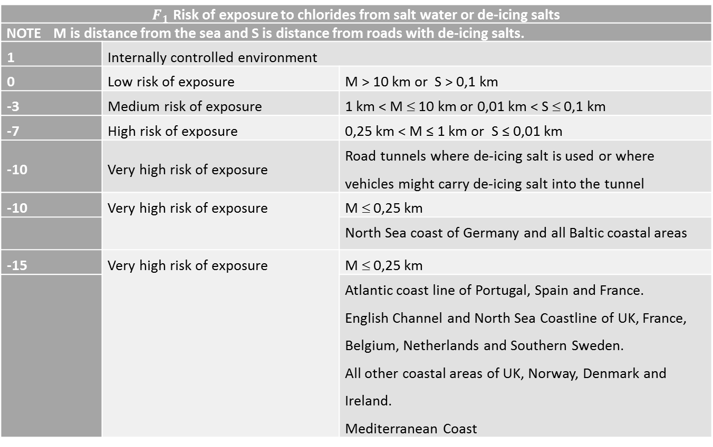
F1 - Evaluation
$F_{1}$ Risk of exposure to chlorides from salt water or de-icing salts
NOTE M is distance from the sea and S is distance from roads with de-icing salts.
1 | Internally controlled environment
0 | Low risk of exposure | M > 10 km or S > 0,1 km
-3 | Medium risk of exposure | 1 km < M ≤ 10 km or 0,01 km < S ≤ 0,1 km
-7 | High risk of exposure | 0,25 km < M ≤ 1 km or S ≤ 0,01 km
-10 | Very high risk of exposure | Road tunnels where de-icing salt is used or where vehicles might carry de-icing salt into the tunnel
-10 | Very high risk of exposure | M ≤ 0,25 km
 |  | North Sea coast of Germany and all Baltic coastal areas
-15 | Very high risk of exposure | M ≤ 0,25 km
 |  | Atlantic coast line of Portugal, Spain and France. English Channel and North Sea Coastline of UK, France, Belgium, Netherlands and Southern Sweden. All other coastal areas of UK, Norway, Denmark and Ireland. Mediterranean Coast
Notes:
For F1 - Note: Column 1 is a qualitative relative ranking of risk
For F2 - Notes: Column 1 is a qualitative relative ranking of risk Values in brackets are broadly derived from data in Annex B of ISO 9223:2012
For F3 - Note: Column 1 is a qualitative relative ranking of risk

Slide 22
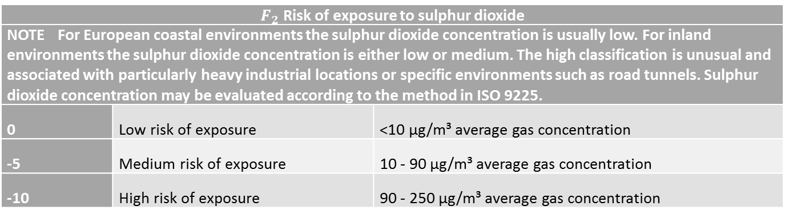
F2 - Evaluation
$F_{2}$ Risk of exposure to sulphur dioxide
NOTE For European coastal environments the sulphur dioxide concentration is usually low. For inland environments the sulphur dioxide concentration is either low or medium. The high classification is unusual and associated with particularly heavy industrial locations or specific environments such as road tunnels. Sulphur dioxide concentration may be evaluated according to the method in ISO 9225.
0 | Low risk of exposure | <10 µg/m³ average gas concentration
-5 | Medium risk of exposure | 10 - 90 µg/m³ average gas concentration
-10 | High risk of exposure | 90 - 250 µg/m³ average gas concentration
Notes:
For F1 - Note: Column 1 is a qualitative relative ranking of risk
For F2 - Notes: Column 1 is a qualitative relative ranking of risk Values in brackets are broadly derived from data in Annex B of ISO 9223:2012
For F3 - Note: Column 1 is a qualitative relative ranking of risk

Slide 23
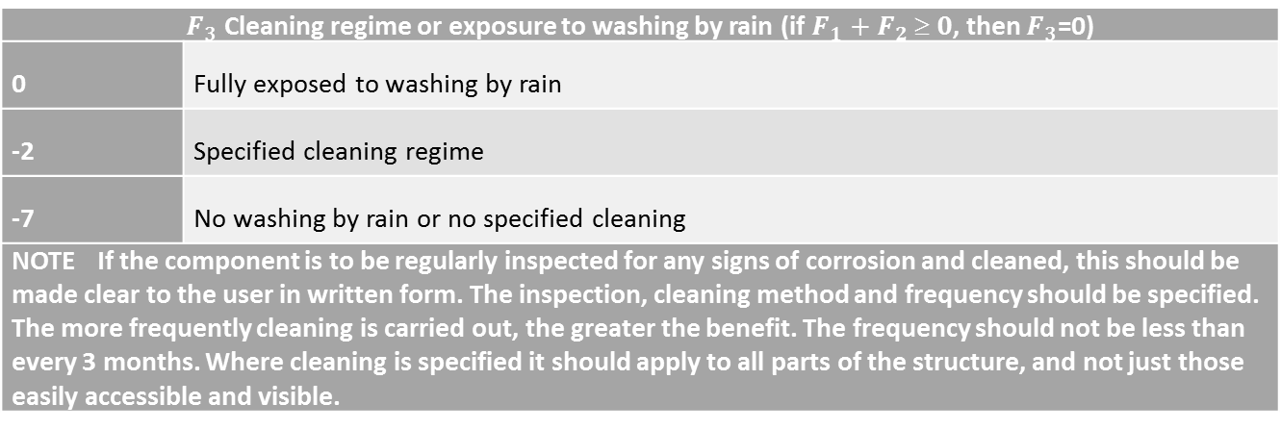
F3 - Evaluation
$F_{3}$ Cleaning regime or exposure to washing by rain (if $F_{1}+F_{2}  0$, then $F_{3}$=0)
0 | Fully exposed to washing by rain
-2 | Specified cleaning regime
-7 | No washing by rain or no specified cleaning
NOTE If the component is to be regularly inspected for any signs of corrosion and cleaned, this should be made clear to the user in written form. The inspection, cleaning method and frequency should be specified. The more frequently cleaning is carried out, the greater the benefit. The frequency should not be less than every 3 months. Where cleaning is specified it should apply to all parts of the structure, and not just those easily accessible and visible.
Notes:
For F1 - Note: Column 1 is a qualitative relative ranking of risk
For F2 - Notes: Column 1 is a qualitative relative ranking of risk Values in brackets are broadly derived from data in Annex B of ISO 9223:2012
For F3 - Note: Column 1 is a qualitative relative ranking of risk

Slide 24
Grade selection procedure
Corrosion Resistance Factor (CRF)
For the environment
Corrosion Resistance Class (CRC)
Corrosion Resistance Factor (CRF) | Corrosion Resistance Class (CRC)
CRF = 1 | I
0 ≥ CRF > -7 | II
-7 ≥ CRF > -15 | III
-15 ≥ CRF ≥ -20 | IV
CRF < -20 | V
Corrosion resistance class CRC
I | II | III | IV | V
1.4003 | 1.4301 | 1.4401 | 1.4439 | 1.4565
1.4016 | 1.4307 | 1.4404 | 1.4462 | 1.4529
1.4512 | 1.4311 | 1.4435 | 1.4539 | 1.4547
 | 1.4541 | 1.4571 |  | 1.4410
 | 1.4318 | 1.4429 |  | 1.4501
 | 1.4306 | 1.4432 |  | 1.4507
 | 1.4567 | 1.4162
 | 1.4482 | 1.4662
 |  | 1.4362
 |  | 1.4062
 |  | 1.4578
NOTE 1 The Corrosion Resistance Classes are only intended for use with this grade selection procedure and are only applicable to structural applications. NOTE 2 A grade from a higher class may be used in place of the class indicated by the CRF.

Slide 25
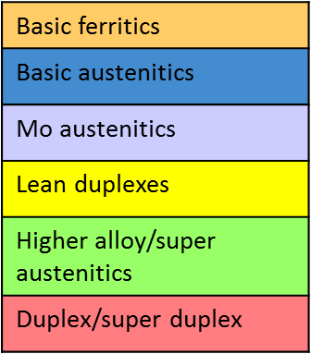
Grade selection procedure
Increasing alloy additions, i.e. more corrosion resistant
More negative values of CRF require more resistant alloy.
Corrosion resistance class CRC
I | II | III | IV | V
1.4003 | 1.4301 | 1.4401 | 1.4439 | 1.4565
1.4016 | 1.4307 | 1.4404 | 1.4539 | 1.4529
1.4512 | 1.4311 | 1.4435 | 1.4462 | 1.4547
 | 1.4541 | 1.4571 |  | 1.4410
 | 1.4318 | 1.4429 |  | 1.4501
 | 1.4306 | 1.4432 |  | 1.4507
 | 1.4567 | 1.4578
 | 1.4482 | 1.4662
 |  | 1.4362
 |  | 1.4062
 |  | 1.4162
NOTE 1 The Corrosion Resistance Classes are only intended for use with this grade selection procedure and are only applicable to structural applications. NOTE 2 A grade from a higher class may be used in place of the class indicated by the CRF.

Slide 26
Properties of Stainless Steel
PUREST

Slide 27
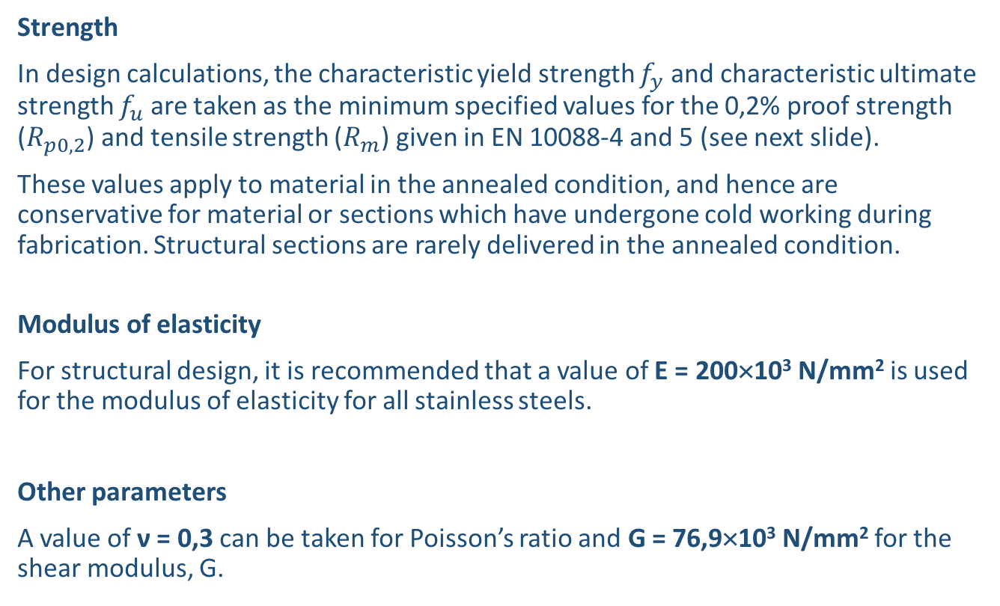
Mechanical Characteristics
Strength
In design calculations, the characteristic yield strength $f_{y}$ and characteristic ultimate strength $f_{u}$ are taken as the minimum specified values for the 0,2% proof strength ($R_{p0,2}$) and tensile strength ($R_{m}$) given in EN 10088-4 and 5 (see next slide).
These values apply to material in the annealed condition, and hence are conservative for material or sections which have undergone cold working during fabrication. Structural sections are rarely delivered in the annealed condition.
Modulus of elasticity
For structural design, it is recommended that a value of E = 200×10³ N/mm² is used for the modulus of elasticity for all stainless steels.
Other parameters
A value of ν = 0,3 can be taken for Poisson’s ratio and G = 76,9×10³ N/mm² for the shear modulus, G.

Slide 28
Min. Specified Mechanical Properties
Grade | Strength N/mm² | Ductility % | Stiffness N/mm²
Austenitic Stainless | 200 - 240 | 40 | 200,000
1.4301 & 1.4307
1.4401 & 1.4404
Duplex Stainless | 450 - 530 | 20 | 200,000
Lean: 1.4062, 1.4162, 1.4362 etc
Standard: 1.4462
Carbon Steel | 355 | 22 | 210,000
S355
Stainless steel properties taken from EN 10088 Stainless Steels
Properties are in the ‘annealed’ (softened condition)

Slide 29
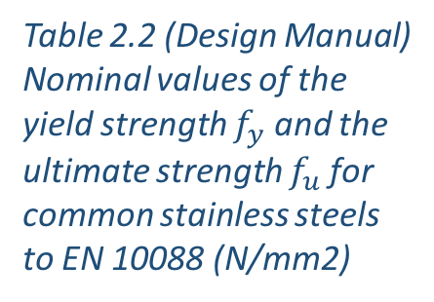
Nominal values of Mechanical Properties
 | Grade | Product form
 |  | Cold rolled strip |  |  | Hot rolled strip |  | Hot rolled plate |  |  |  | Bars, rods & sections
 |  | Nominal thickness t
 |  | t ≤ 8 mm |  |  | t ≤ 13,5 mm |  | t ≤ 75 mm |  |  |  | t or $φ$ ≤ 250 mm
 |  | $$f_{y}$$ | $$f_{u}$$ |  | $$f_{y}$$ | $$f_{u}$$ | $$f_{y}$$ |  |  | $$f_{u}$$ | $$f_{y}$$ | $$f_{u}$$
Austenitic | 1.4301 | 230 | 540 |  | 210 | 520 | 210 |  | 520 |  | 190 | 500
 | 1.4307 | 220 | 520 |  | 200 | 520 | 200 |  | 500 |  | 175 | 500
 | 1.4318 | 350 | 650 |  | 330 | 650 | 330 |  | 630 |  | - | -
 | 1.4401 | 240 | 530 |  | 220 | 530 | 220 |  | 520 |  | 200 | 500
 | 1.4404 | 240 | 530 |  | 220 | 530 | 220 |  | 520 |  | 200 | 500
 | 1.4541 | 220 | 520 |  | 200 | 520 | 200 |  | 500 |  | 190 | 500
 | 1.4571 | 240 | 540 |  | 220 | 540 | 220 |  | 520 |  | 200 | 500
Duplex | 1.4062 | 530 ¹ | 700 ¹ |  | 480 ² | 680 ² | 450 |  | 650 |  | 380 ³ | 650 ³
 | 1.4162 | 530 ¹ | 700 ¹ |  | 480 ² | 680 ² | 450 |  | 650 |  | 450 ³ | 650 ³
 | 1.4362 | 450 | 650 |  | 400 | 650 | 400 |  | 630 |  | 400 ³ | 600 ³
 | 1.4462 | 500 | 700 |  | 460 | 700 | 460 |  | 640 |  | 450 ³ | 650 ³
 | 1.4482 | 500 ¹ | 700 ¹ |  | 480 ² | 660 ² | 450 |  | 650 |  | 400 ³ | 650 ³
 | 1.4662 | 550 ¹ | 750 ¹ |  | 550 ⁴ | 750 ⁴ | 480 |  | 680 |  | 450 ³ | 650 ³
Ferritic | 1.4003 | 280 | 450 |  | 280 | 450 | 250 ⁵ |  | 450 ⁵ |  | 260 ⁶ | 450 ⁶
 | 1.4016 | 260 | 450 |  | 240 | 450 | 240 ⁵ |  | 430 ⁵ |  | 240 ⁶ | 400 ⁶
 | 1.4509 | 230 | 430 |  | - | - | - |  | - |  | 200 ⁷ | 420 ³
 | 1.4521 | 300 | 420 |  | 280 | 400 | 280 ⁸ |  | 420 ⁸ |  | - | -
 | 1.4621 | 230 ⁵ | 400 ⁹ |  | 230 ⁸ | 400 ⁸ | - |  | - |  | 240 ⁷ | 420 ⁷
The nominal values of $f_{y}$ and $f_{u}$ given in this table may be used in design without taking special account of anisotropy or strain hardening effects. For ferritic stainless steels, EN 10088-4 gives $f_{y}$ values in the longitudinal and transvers direction. This table gives the longitudinal values which are generally about 20 N/mm² lower than the transverse values. 1.4621, 1.4482, 1.4062 and 1.4662 are only covered in EN 10088-2 and 3. 1.4509 bar is only covered in EN 10088-3.
¹ t ≤ 6,4 mm ² t ≤ 10 mm ³ t or $φ$ ≤ 160 mm |  |  |  | ⁴ t ≤ 13 mm ⁵ t ≤ 25 mm ⁶ t or $φ$ ≤ 100 mm |  |  |  | ⁷ t or $φ$ ≤ 50 mm ⁸ t ≤ 12 mm ⁹ t ≤ 6 mm
Table 2.2 (Design Manual)
Nominal values of the yield strength $f_{y}$ and the ultimate strength $f_{u}$ for common stainless steels to EN 10088 (N/mm2)

Slide 30
Mechanical Characteristics
Energy Absorption
Stainless steel has better intrinsic energy absorption properties than aluminium or carbon steel due to high rate of strain hardening & excellent ductility
Fracture toughness
Austenitic stainless steels
No ductile to brittle transition
Ductile down to cryogenic temperatures
Duplex stainless steels
Ductile to brittle transition like carbon steels
Adequate toughness down to -40 °C
Care when using welded connections to maintain HAZ toughness
Ductile Brittle Transition Curve (DBTT)
Ductile tearing
Austenitic steel
Energy Absorbed
Duplex steel
Carbon steels
Brittle fracture
Temperature

Slide 31
Stress-strain Characteristics
The stress-strain characteristics for stainless steel is fundamentally different compared to carbon steel.
“strain hardening”
Niet elastisch gedrag

Slide 32

Ramberg-Osgood Material Model
Ramberg-Osgood material model
For stainless steel, it displays a rounded stress–strain curve, with no sharp yield point, considerable strain hardening and high ductility.
Instead of using a elastic, perfectly-plastic material model, the Ramberg-Osgood material model is employed.
In the material model, the most important parameter is the exponent ‘n’, which defines degree of roundness of the material curve, at low strain.

Slide 33
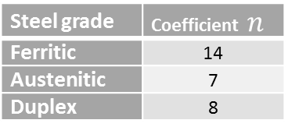
Ramberg-Osgood Material Model
The values of ‘n’ for each stainless steel grade and the orientation to the rolling direction defined in the Eurocode EN 1993-1-4 is summarized in the table.
Table 6.5: Values of n to be used for determining secant moduli EN 1993-1-4
Type | Grade | Coefficient n
 |  | Longitudinal direction | Transverse direction
Ferritic | 1.4003 | 7 | 11
 | 1.4016 | 6 | 14
 | 1.4512 | 9 | 16
Austenitic | 1.4301, 1.4306, 1.4307, 1.4318, 1.4541 | 6 | 8
 | 1.4401, 1.4404, 1.4432, 1.4435, 1.4539, 1.4571, | 7 | 9
Duplex | 1.4462, 1.4362 | 5 | 5
Note: If the orientation of the member is not known, or cannot be ensured, then it is conservative to use the value for the longitudinal direction.
Table 6.4: Values of n to be
used for determining
secant modulus
Steel grade | Coefficient $n$
Ferritic | 14
Austenitic | 7
Duplex | 8
Note that the values for duplex were based on very few data and are now understood to be too low. It is expected that the values in this table will be replaced by those in Table 6.4 in the next revision of EN 1993-1-4.

Slide 34
Impact of Stress-Strain Characteristics
Impact on buckling performance:
Low slenderness Columns attain/exceed the squash load ⇒ benefits of strain hardening apparent stainless steel behaves at least as well as carbon steel
High slenderness Axial strength low, stresses low and in linear region ⇒ Stainless steel behaves similarly to carbon steel, providing geometric and residual stresses similar
Intermediate slenderness Average stress in column lies between the limit of proportionality and the 0.2% permanent strain, ⇒ Stainless steel column less strong than carbon steel column

Slide 35
Strain Hardening
Strain hardening is also known as work hardening or cold working. The phenomenon results in an increase of strength by plastic deformation caused by cold-forming either during steel production operations at the mill or during fabrication processes.
For instance, during the fabrication of a rectangular hollow section, the 0.2% proof strength increases by about 50% in the cold-formed corners of cross sections!

Slide 36
Strain Hardening
Strength enhancement (and loss of ductility) due to cold-working:
Stress
Enhanced σ_{0.2}
Initial loading/ unloading
σ_{0.2}
Subsequent loading
E
E
E
0.2%
0.2%
Strain
Strength Enhancement may be taken into account using Annex B of Design Manual, see Chapter “Strength Enhancement of Cold Formed sections” of this document.

Slide 37
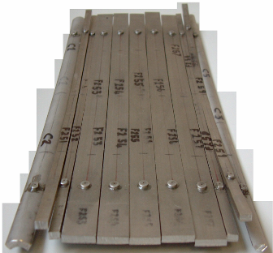
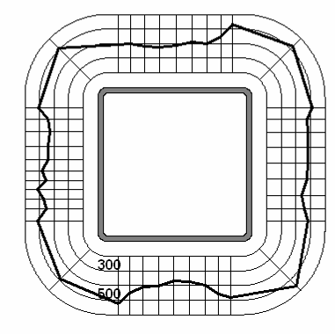
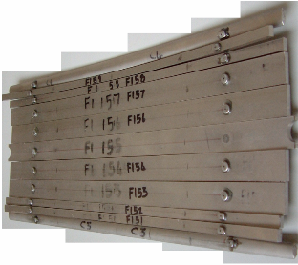
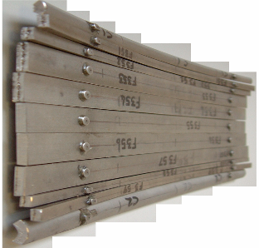
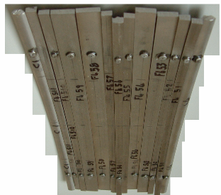
Strain Hardening
Strength enhancement during forming
σ_{0.2,meas}
σ_{0.2,mill}
σ_{0.2,min}
weld
Cruise, R. B. and Gardner, L. (2008). Strength enhancements induced during cold forming of stainless steel sections. Journal of Constructional Steel Research. 64(11), 1310-1316.

Slide 38
Strain Hardening
Strain hardening is not always useful:
Heavier and more powerful fabrication equipment since greater forces are required
Reduced ductility (however, the initial ductility is high, especially for austenitic grades)
Undesirable residual stresses may be produced

Slide 39
Stainless Steel Design Rules
PUREST

Slide 40
Eurocode 3
Eurocode 3: Design of Steel Structures, Part 1.4 Supplementary rules for stainless steels
Modifies and supplements rules for carbon steel given in other parts of Eurocode 3 where necessary
Applies to buildings, bridges, tanks etc
CEN. (2015). NBN EN 1993-1-4/A1, Eurocode 3 - Design of steel structures - Part 1-4: General rules – Supplementary rules for stainless steels. Brussels. Supplementary Amendments

Slide 41
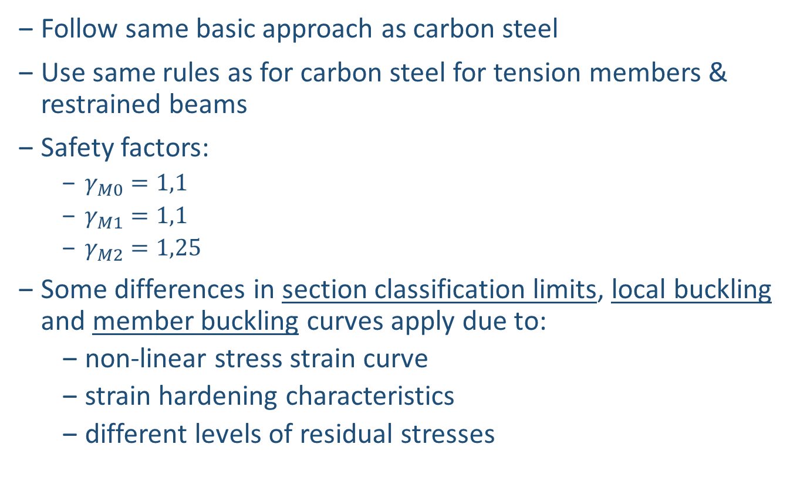
Eurocode 3
Follow same basic approach as carbon steel
Use same rules as for carbon steel for tension members & restrained beams
Safety factors:
$γ_{M0}=1,1$
$γ_{M1}=1,1$
$γ_{M2}=1,25$
Some differences in section classification limits, local buckling and member buckling curves apply due to:
non-linear stress strain curve
strain hardening characteristics
different levels of residual stresses

Slide 42
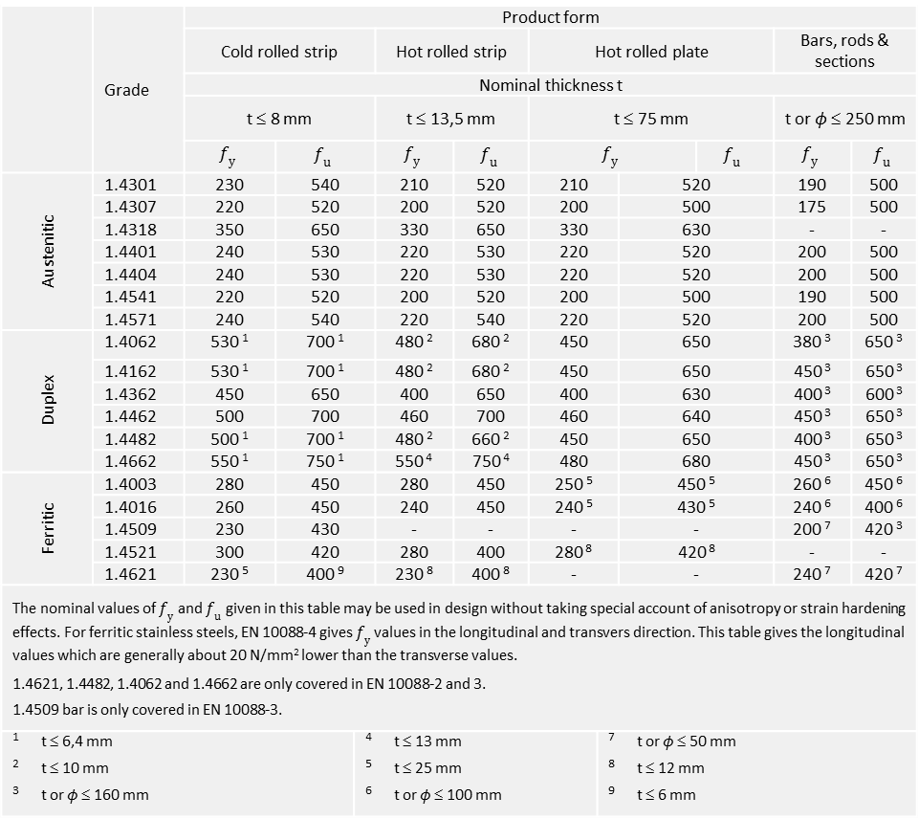
Eurocode 3
 | Grade | Product form
 |  | Cold rolled strip |  |  | Hot rolled strip |  | Hot rolled plate |  |  |  | Bars, rods & sections
 |  | Nominal thickness t
 |  | t ≤ 8 mm |  |  | t ≤ 13,5 mm |  | t ≤ 75 mm |  |  |  | t or $φ$ ≤ 250 mm
 |  | $$f_{y}$$ | $$f_{u}$$ |  | $$f_{y}$$ | $$f_{u}$$ | $$f_{y}$$ |  |  | $$f_{u}$$ | $$f_{y}$$ | $$f_{u}$$
Austenitic | 1.4301 | 230 | 540 |  | 210 | 520 | 210 |  | 520 |  | 190 | 500
 | 1.4307 | 220 | 520 |  | 200 | 520 | 200 |  | 500 |  | 175 | 500
 | 1.4318 | 350 | 650 |  | 330 | 650 | 330 |  | 630 |  | - | -
 | 1.4401 | 240 | 530 |  | 220 | 530 | 220 |  | 520 |  | 200 | 500
 | 1.4404 | 240 | 530 |  | 220 | 530 | 220 |  | 520 |  | 200 | 500
 | 1.4541 | 220 | 520 |  | 200 | 520 | 200 |  | 500 |  | 190 | 500
 | 1.4571 | 240 | 540 |  | 220 | 540 | 220 |  | 520 |  | 200 | 500
Duplex | 1.4062 | 530 ¹ | 700 ¹ |  | 480 ² | 680 ² | 450 |  | 650 |  | 380 ³ | 650 ³
 | 1.4162 | 530 ¹ | 700 ¹ |  | 480 ² | 680 ² | 450 |  | 650 |  | 450 ³ | 650 ³
 | 1.4362 | 450 | 650 |  | 400 | 650 | 400 |  | 630 |  | 400 ³ | 600 ³
 | 1.4462 | 500 | 700 |  | 460 | 700 | 460 |  | 640 |  | 450 ³ | 650 ³
 | 1.4482 | 500 ¹ | 700 ¹ |  | 480 ² | 660 ² | 450 |  | 650 |  | 400 ³ | 650 ³
 | 1.4662 | 550 ¹ | 750 ¹ |  | 550 ⁴ | 750 ⁴ | 480 |  | 680 |  | 450 ³ | 650 ³
Ferritic | 1.4003 | 280 | 450 |  | 280 | 450 | 250 ⁵ |  | 450 ⁵ |  | 260 ⁶ | 450 ⁶
 | 1.4016 | 260 | 450 |  | 240 | 450 | 240 ⁵ |  | 430 ⁵ |  | 240 ⁶ | 400 ⁶
 | 1.4509 | 230 | 430 |  | - | - | - |  | - |  | 200 ⁷ | 420 ³
 | 1.4521 | 300 | 420 |  | 280 | 400 | 280 ⁸ |  | 420 ⁸ |  | - | -
 | 1.4621 | 230 ⁵ | 400 ⁹ |  | 230 ⁸ | 400 ⁸ | - |  | - |  | 240 ⁷ | 420 ⁷
The nominal values of $f_{y}$ and $f_{u}$ given in this table may be used in design without taking special account of anisotropy or strain hardening effects. For ferritic stainless steels, EN 10088-4 gives $f_{y}$ values in the longitudinal and transvers direction. This table gives the longitudinal values which are generally about 20 N/mm² lower than the transverse values. 1.4621, 1.4482, 1.4062 and 1.4662 are only covered in EN 10088-2 and 3. 1.4509 bar is only covered in EN 10088-3.
¹ t ≤ 6,4 mm ² t ≤ 10 mm ³ t or $φ$ ≤ 160 mm |  |  |  | ⁴ t ≤ 13 mm ⁵ t ≤ 25 mm ⁶ t or $φ$ ≤ 100 mm |  |  |  | ⁷ t or $φ$ ≤ 50 mm ⁸ t ≤ 12 mm ⁹ t ≤ 6 mm

Slide 43
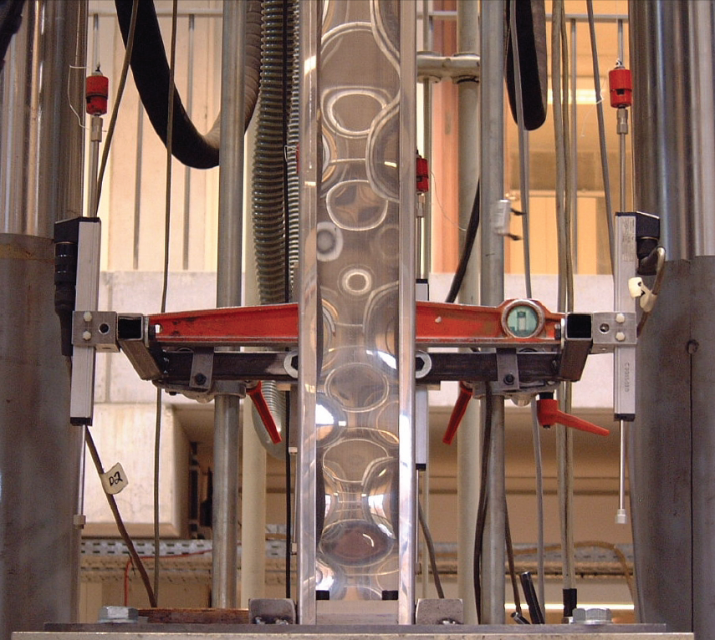
Section Classification & Local Buckling
In compression, because of small thicknesses, the behaviour of plates is affected by instability phenomena called LOCAL buckling.
Local buckling prevents the cross-section to attain the elastic resistance

Slide 44
Section Classification & Local Buckling
Classification is required to decide about the type of cross-section verification:
Elastic verification
Plastic (or partial plastic) verification
Effective cross-section properties (‘reduced’ cross-section properties: A_{eff} and I_{eff})
Class 1 can form a plastic hinge, have sufficient rotation capacity
Class 2 cross-sections are those which can develop their plastic moment resistance, but have limited rotation capacity because of local buckling
Class 3 cross-sections are those in which the stress in the extreme compression fibre of the steel member assuming an elastic distribution of stresses can reach the yield strength, but local buckling is liable to prevent development of the plastic moment resistance
Class 4 cross-sections are those in which local buckling will occur before the attainment of yield stress in one or more parts of the cross-section

Slide 45
Section Classification & Local Buckling
Classification of a cross-section
depends on the classification of all its constitutive plate elements totally or partially in compression
is mainly governed by the plate slenderness c/t
cross-section class = most unfavorable class of its constitutive plate elements in compression
EN 1993-1-4 gives lower limiting width-to-thickness ratios than for carbon steel and slightly different expressions for calculating effective widths of slender elements. The new version of EN 1993-1-4 contains less conservative limits & effective width expressions.

Slide 46
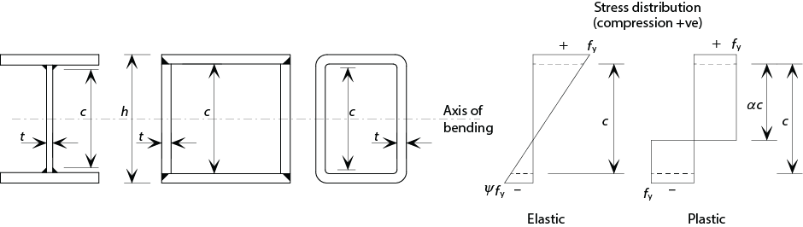

Section Classification & Local Buckling
Internal compression parts
$$ε=\sqrt{\frac{235}{f_{y}} \frac{E}{210000}}$$
 | EC3-1-1: carbon steel |  | EC3-1-4: stainless steel |  | EC3-1-4: New revision
Class | Bending | Compression | Bending | Compression | Bending | Compression
1 | c/t ≤ 72ε | c/t ≤ 33ε | c/t ≤ 56ε | c/t ≤ 25,7ε | c/t ≤ 72ε | c/t ≤ 33ε
2 | c/t ≤ 83ε | c/t ≤ 38ε | c/t ≤ 58,2ε | c/t ≤ 26,7ε | c/t ≤ 76ε | c/t ≤ 35ε
3 | c/t ≤ 124ε | c/t ≤ 42ε | c/t ≤ 74,8ε | c/t ≤ 30,7ε | c/t ≤ 90ε | c/t ≤ 37ε

Slide 47
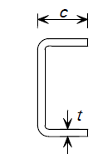
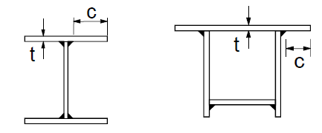
Section Classification & Local Buckling
External compression parts
 | EC3-1-1: carbon steel | EC3-1-4: stainless steel |  | EC3-1-4: New revision
Class | Compression | Compression Welded | Compression Cold-formed | Compression
1 | c/t ≤ 9ε | c/t ≤ 9ε | c/t ≤ 10ε | c/t ≤ 9ε
2 | c/t ≤ 10ε | c/t ≤ 9,4ε | c/t ≤ 10,4ε | c/t ≤ 10ε
3 | c/t ≤ 14ε | c/t ≤ 11ε | c/t ≤ 11,9ε | c/t ≤ 14ε

Slide 48
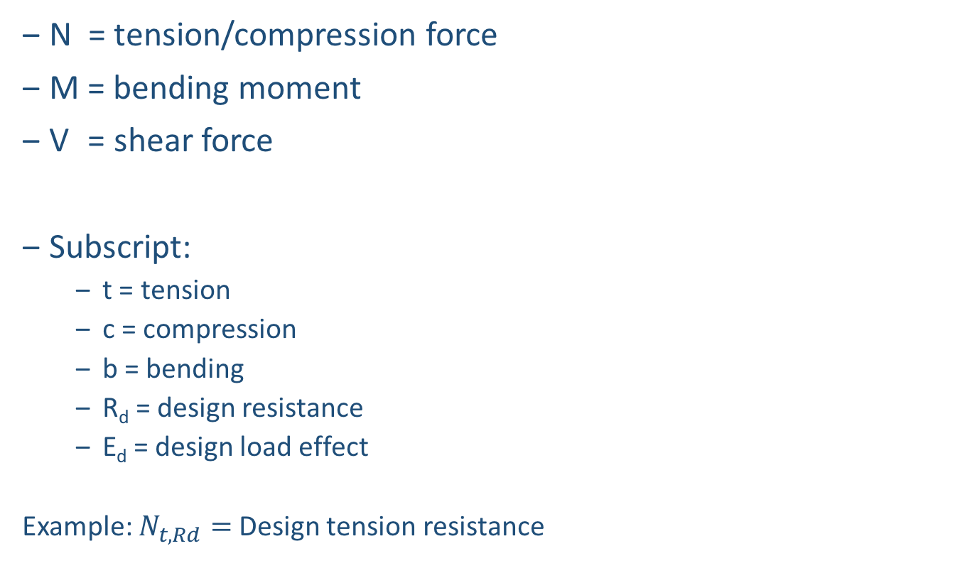
Recap Naming System
𝜎
N = tension/compression force
M = bending moment
V = shear force
Subscript:
t = tension
c = compression
b = bending
R_{d} = design resistance
E_{d} = design load effect
Example: $N_{t,Rd}=$ Design tension resistance
E
d
Ed
M
Ed
E
𝜎
Ed
d
N
Ed
E
τ
Ed
d
V
Ed

Slide 49
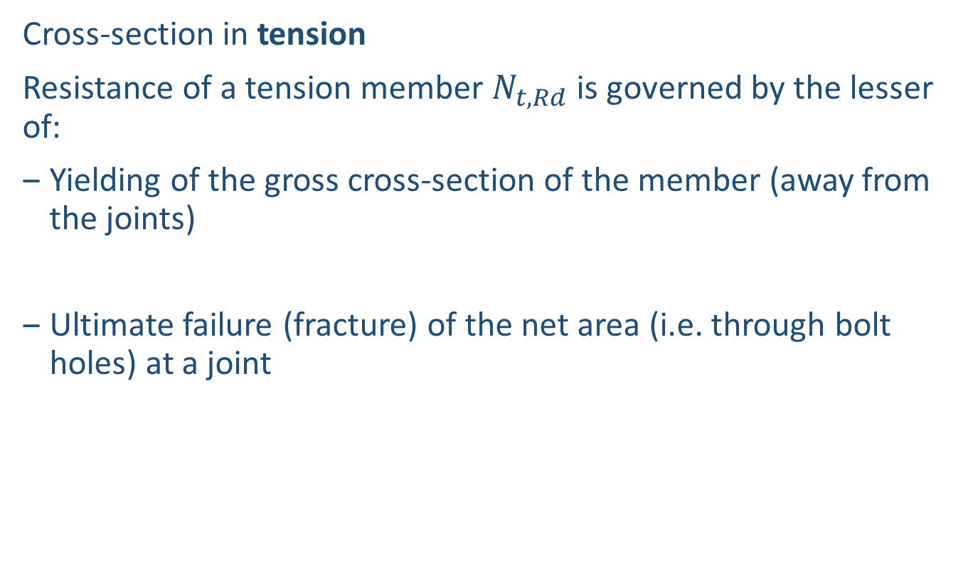
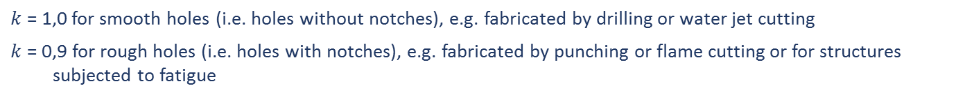


Cross-section Verification
Cross-section in tension
Resistance of a tension member $N_{t,Rd}$ is governed by the lesser of:
Yielding of the gross cross-section of the member (away from the joints)
Ultimate failure (fracture) of the net area (i.e. through bolt holes) at a joint
$$N_{pl,Rd}=\frac{A_{g}f_{y}}{γ_{M0}}$$
$$N_{u,Rd}=\frac{{k A_{net} f}_{u}}{γ_{M2}}$$
$k$ = 1,0 for smooth holes (i.e. holes without notches), e.g. fabricated by drilling or water jet cutting
$k$= 0,9 for rough holes (i.e. holes with notches), e.g. fabricated by punching or flame cutting or for structures subjected to fatigue

Slide 50

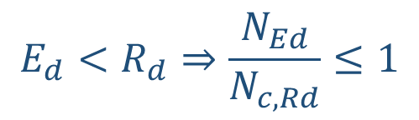

Cross-section Verification
Cross-section in compression
Class 1, 2 and 3 cross-sections
Class 4 : local buckling so effective properties should be used
$$E_{d}<R_{d}⇒\frac{N_{Ed}}{N_{c,Rd}}≤1$$
$$N_{c,Rd}=\frac{Af_{y}}{γ_{M0}}$$
$$N_{c,Rd}=\frac{A_{eff}f_{y}}{γ_{M0}}$$

Slide 51
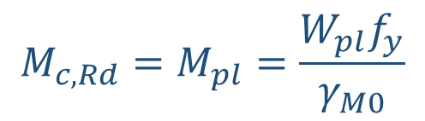
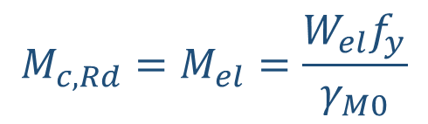
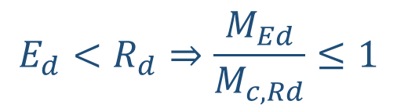

Cross-section Verification
Cross-section in bending
Class 1 and 2 cross-sections
Class 3 cross-sections (local buckling)
Class 4 : local buckling so effective properties should be used
$$E_{d}<R_{d}⇒\frac{M_{Ed}}{M_{c,Rd}}≤1$$
$$M_{c,Rd}=M_{pl}=\frac{W_{pl}f_{y}}{γ_{M0}}$$
$$M_{c,Rd}=M_{el}=\frac{W_{el}f_{y}}{γ_{M0}}$$
$$M_{c,Rd}=\frac{W_{eff}f_{y}}{γ_{M0}}$$

Slide 52
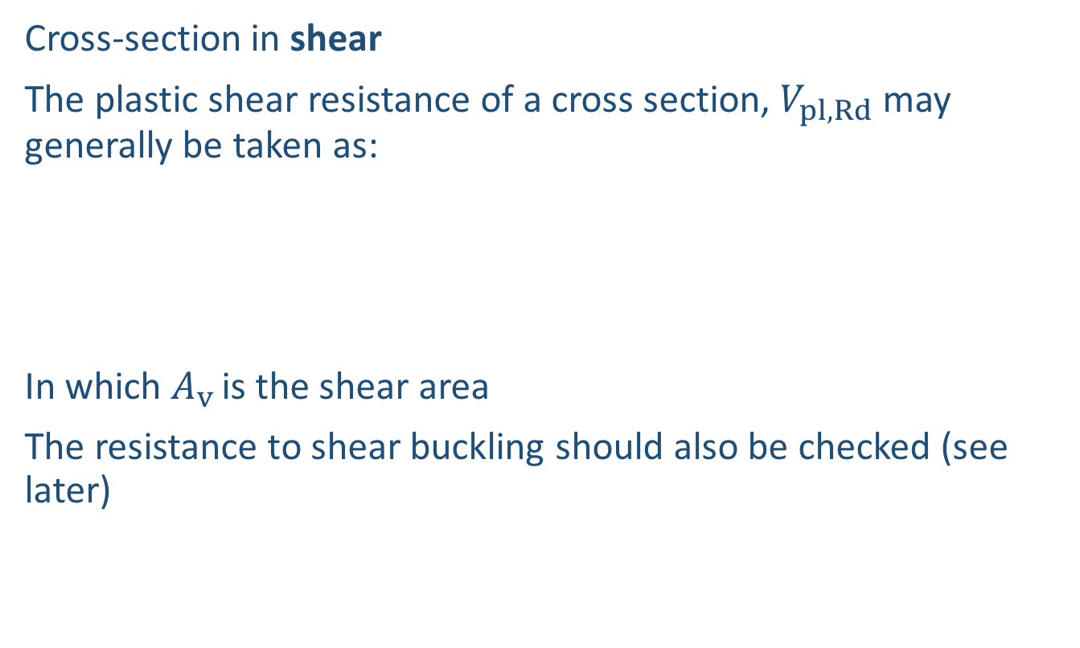
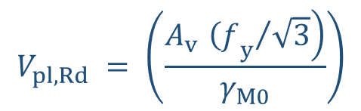
Cross-section Verification
Cross-section in shear
The plastic shear resistance of a cross section, $V_{pl,Rd}$ may generally be taken as:
In which $A_{v }$is the shear area
The resistance to shear buckling should also be checked (see later)
$$V_{pl,Rd} = \left(\frac{\left.A_{v }{{\left(f\right.}_{y}}/{\sqrt{3}}\right)}{γ_{M0}}\right)$$

Slide 53


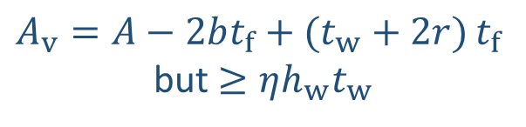
Cross-section Verification
Welded I, H and box sections, load parallel to web:
Rolled I and H sections, load parallel to web:
A_{v}
A_{v}
$$A_{v}=η\sum{h_{w}t_{w}}$$
$A_{v}=A−2bt_{f}+(t_{w}+2r) t_{f}$
but $≥ηh_{w}t_{w}$
EN 1993-1-4 recommends $η$ = 1,20

Slide 54
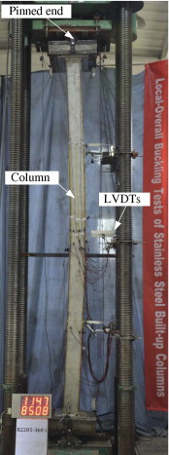
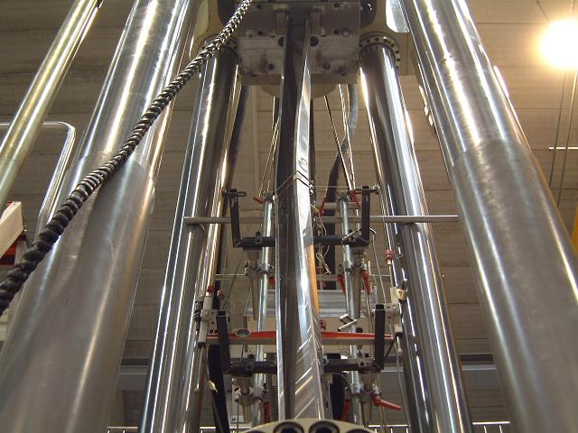
Design of Columns & Beams
In compression, because of the global dimension of the column, the behaviour is affected by instability phenomena. Those instabilities often take the form of GLOBAL lateral buckling about the weak axis.

Slide 55

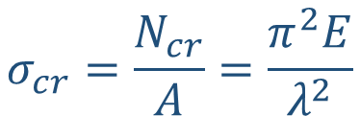


Design of Columns & Beams
Properties of the cross-section:
“i” radius of gyration which to the considered buckling plane, it has the dimension of a length [m].
Member slenderness as
So that:
$$i^{2}=\frac{I}{A}$$
$$λ=\frac{L_{cr}}{i}$$
$$λ≠\frac{c}{t}≠\overline{λ}$$
$$σ_{cr}=\frac{N_{cr}}{A}=\frac{π^{2}E}{λ^{2}}$$
Buckling is governed by the slenderness

Slide 56
Design of Columns & Beams
“Perfect” column behaviour
Two bounds: Yielding (cross-section strength) and buckling:
Load
Material yielding (squashing)
N_{Ed}
Af_{y}
L_{cr}
Euler (critical) buckling N_{cr}
N_{Ed}
Yielding
Buckling
Slenderness

Slide 57
Design of Columns & Beams
“Perfect” column behaviour
Two bounds: Yielding (cross-section strength) and buckling:
Load
Material yielding (squashing)
N_{Ed}
Af_{y}
L_{cr}
Medium slenderness
N_{Ed}
Slenderness

Slide 58
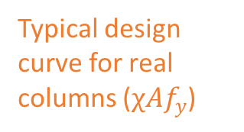
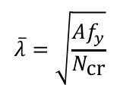
Design of Columns & Beams
Real column behaviour
Two bounds: Yielding (cross-section strength) and buckling:
Load
Material yielding (squashing)
N_{Ed}
Af_{y}
L_{cr}
Elastic buckling N_{cr}
Typical design curve for real columns ($χAf_{y}$)
N_{Ed}
$$\overline{λ}=\sqrt{\frac{Af_{y}}{N_{\text{cr}}}}$$
Non-dimensional slenderness

Slide 59
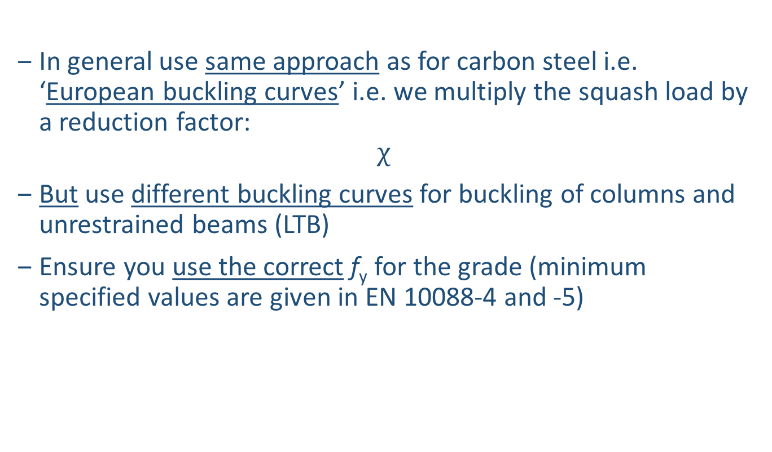
Design of Columns & Beams in EN 1993-1-4
In general use same approach as for carbon steel i.e. ‘European buckling curves’ i.e. we multiply the squash load by a reduction factor:
$$χ$$
But use different buckling curves for buckling of columns and unrestrained beams (LTB)
Ensure you use the correct f_{y} for the grade (minimum specified values are given in EN 10088-4 and -5)

Slide 60
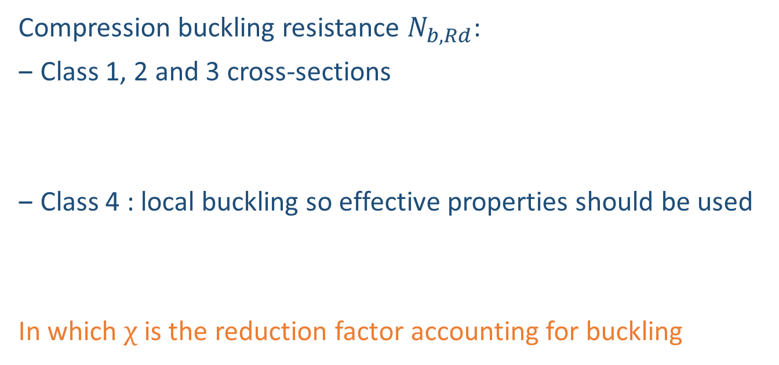



Column Buckling
Compression buckling resistance $N_{b,Rd}$:
Class 1, 2 and 3 cross-sections
Class 4 : local buckling so effective properties should be used
In which $χ$ is the reduction factor accounting for buckling
$$N_{b,Rd}=\frac{χAf_{y}}{γ_{M1}}$$
$$N_{b,Rd}=\frac{{χA}_{eff}f_{y}}{γ_{M1}}$$
The buckling effects may be ignored and only cross sectional checks apply if:
$$\overline{λ}≤{\overline{λ}}_{0} or \frac{N_{\text{Ed}}}{N_{\text{cr}}}≤{{\overline{λ}}_{0}}^{2}$$

Slide 61



Column Buckling
Non-dimensional slenderness:
For class 1, 2 and 3 cross-sections
For class 4 cross-sections
$N_{cr}$ is the elastic critical buckling load for the relevant buckling mode based on the gross properties of the cross-section
$$\overline{λ}=\sqrt{\frac{Af_{\text{y}}}{N_{\text{cr}}}}=\frac{L_{\text{cr}}}{i}\frac{1}{π}\sqrt{\frac{f_{\text{y}}}{E}}$$
$$\overline{λ}=\sqrt{\frac{A_{\text{eff}}f_{\text{y}}}{N_{\text{cr}}}}=\frac{L_{\text{cr}}}{i}\frac{1}{π}\sqrt{\frac{f_{y} \frac{A_{\text{eff}}}{A}}{E}}$$

Slide 62




Column Buckling
Reduction factor:
$$χ=\frac{1}{φ + {\left[φ^{2} − {\overline{λ}}^{2}\right]}^{ 0,5}} ≤ 1$$
$$\left.φ=0,5(1+α(\overline{λ}−{\overline{λ}}_{0})+{\overline{λ}}^{2}\right)$$
${\overline{λ}}_{0}$ is the limiting non-dimensional slenderness defined in Table 6.1 (next slide) or “plateau length”
$α$ is the imperfection factor defined in Table 6.1 (next slide)

Slide 63


Column Buckling
Choice of buckling curve depends on cross-section, manufacturing route and axis:
Table 6.1: Values for α and ${\overline{λ}}_{0}$ for flexural buckling (Design Manual)
Type of member | Axis of buckling | Austenitic and duplex |  | Ferritic
 |  | $$α$$ | $${\overline{λ}}_{0}$$ | $$α$$ | $${\overline{λ}}_{0}$$
Cold formed angles and channels | Any | 0,76 | 0,2 | 0,76 | 0,2
Cold formed lipped channels | Any | 0,49 | 0,2 | 0,49 | 0,2
Cold formed RHS | Any | 0,49 | 0,3 | 0,49 | 0,2
Cold formed CHS/ EHS | Any | 0,49 | 0,2 | 0,49 | 0,2
Hot finished RHS | Any | 0,49 | 0,2 | 0,34 | 0,2
Hot finished CHS/EHS | Any | 0,49 | 0,2 | 0,34 | 0,2
Welded or hot rolled open sections | Major | 0,49 | 0,2 | 0,49 | 0,2
 | Minor | 0,76 | 0,2 | 0,76 | 0,2

Slide 64

Column Buckling
Choice of buckling curve depends on cross-section, manufacturing route and axis:
The buckling curves given in Table 6.1 are more conservative than those in EN 1993-1-4 (values of 𝛼 and λ₀ are given below in Table 6.2). This is because experimental research over the last 10 years has shown that the EN 1993-1-4 buckling curves for cold formed open sections and cold formed hollow sections are unduly optimistic, and that there is a difference in buckling behaviour of ferritic stainless steel cold formed RHS columns compared to austenitic and duplex stainless steels. It is expected that the next revision to EN 1993-1-4 will give the flexural buckling curves in Table 6.1 (see previous slide).
Table 6.2: Values for α and ${\overline{λ}}_{0}$ for flexural and torsional buckling in EN 1993-1-4
Buckling mode | Type of member | $$α$$ | $${\overline{λ}}_{0}$$
Flexural | Cold formed open sections | 0,49 | 0,4
 | Hollow sections (welded and seamless) | 0,49 | 0,4
 | Welded open sections (major axis) | 0,49 | 0,2
 | Welded open sections (minor axis) | 0,76 | 0,2
The values for 𝛼 and ${\overline{λ}}_{0}$ do not apply to hollow sections if they are annealed after fabrication (which is rarely the case).

Slide 65

Column Buckling
Flexural buckling curves:

Slide 66


Example: Flexural Buckling
Use new example from Maarten
Cold formed rectangular hollow section submitted to concentric compression
Material | Carbon steel S235 | Austenitic stainless steel EN 1.4301
f_{y} | 235 N/mm² | 230 N/mm²
E | 210 000 N/mm² | 200 000 N/mm²

Slide 67

Example: Flexural Buckling
 | EC 3-1-1: S235 | EC 3-1-4: Austenitic | DM: Austenitic
$$A [mm²]$$ | 1495 | 1495 | 1495
$$I [{mm}^{4}]$$ | 2260000 | 2260000 | 2260000
$$E [N/mm²]$$ | 210000 | 200000 | 200000
$$f_{y} [N/mm²]$$ | 235 | 230 | 230
$${γ }_{M0} [−]$$ | 1,0 | 1,1 | 1,1
$${γ }_{M1} [−]$$ | 1,0 | 1,1 | 1,1
$$ε [−]$$ | 1 | 0,99 | 0,99
Class | Class 1 | Class 1 | Class 1
$$L_{cr} [mm]$$ | 2100 | 2100 | 2100
$$N_{c,Rd} [kN]$$ | 351 | 313 | 313
$$N_{cr} [kN]$$ | 1062 | 1012 | 1012
$$\overline{λ} [−]$$ | 0,575 | 0,583 | 0,583
$$α [−]$$ | 0,49 | 0,49 | 0,49
$${\overline{λ}}_{0} [−]$$ | 0,2 | 0,4 | 0,3
$$ϕ [−]$$ | 0,757 | 0,715 | 0,739
$$χ [−]$$ | 0,8 | 0,89 | 0,84
$$N_{b,Rd} [kN]$$ | 281 | 278 | 262

Slide 68

Example: Flexural Buckling
Comparison:
In this example, cs and ss show similar resistance to flexural buckling ⇒ benefits of strain hardening not apparent EC3 1-4 doesn’t take duly account for strain hardening/cold-working
 | EC 3-1-1: S235 | EC 3-1-4: Austenitic | DM: Austenitic
$$f_{y} [N/mm²]$$ | 235 | 230 | 230
$${γ }_{M0} [−]$$ | 1,0 | 1,1 | 1,1
$${γ }_{M1} [−]$$ | 1,0 | 1,1 | 1,1
$$N_{c,Rd} [kN]$$ | 351 | 313 | 313
$$N_{b,Rd} [kN]$$ | 281 | 277 | 262

Slide 69

Lateral Torsional Buckling (LTB)
Can be discounted when:
Beams subject to bending only about the minor axis
Beams with sufficient restraint to the compression flange throughout their length by adequate bracing
Beams where the lateral non-dimensional slenderness parameter ${\overline{λ}}_{LT}≤0,4 or \frac{M_{\text{Ed}}}{M_{\text{cr}}}≤0,16$
Beams with certain types of cross-sections, such as square or circular hollow sections, which are not susceptible to lateral-torsional buckling.
LTB

Slide 70

Lateral Torsional Buckling (LTB)
The design approach for lateral torsional buckling is analogous to the column buckling treatment.
M
Material yielding (in-plane bending)
W_{y}f_{y}
M_{Ed}
M_{Ed}
Elastic member buckling M_{cr}
L_{cr}
Yielding
Buckling
$${\overline{λ}}_{LT}$$
Non-dimensional slenderness

Slide 71






Lateral Torsional Buckling (LTB)
The design buckling resistance $M_{b,Rd}$ of a laterally unrestrained beam (or segment of beam) should be taken as:
In which $χ_{LT}$ is the reduction factor for LTB:
$$M_{b,Rd}=χ_{LT}W_{y}\frac{f_{y}}{γ_{M1}}$$
$$χ_{\text{LT}}=\frac{1}{φ_{\text{LT}} + [{φ_{\text{LT}}}^{2} − {{\overline{λ}}_{\text{LT}}}^{2}] ^{0,5}} ≤ 1$$
$α_{LT}$ is the imperfection factor
= 0,34 for cold formed sections and hollow sections (welded and seamless)
= 0,76 for welded open sections and other sections for which no test data is available.
$M_{cr}$ is the elastic critical moment for lateral torsional buckling (see ANNEX E).
$$φ_{\text{LT}}=0,5\left(1 + α_{LT}({\overline{λ}}_{\text{LT}} −0,4) + {{\overline{λ}}_{\text{LT}}}^{2}\right)$$
$${\overline{λ}}_{\text{LT}}=\sqrt{\frac{W_{\text{y} }f_{\text{y}}}{M_{\text{cr}}}}$$
Plateau length
Imperfection factor

Slide 72




Shear Buckling Resistance
With large web heights the risk of introducing shear buckling increases. The shear buckling resistance only requires checking when:
$\frac{h_{w}}{t}≥\frac{56,2ε}{η}$ for an unstiffened web
$\frac{h_{w}}{t}≥\frac{24,3ε\sqrt{k_{t}}}{η}$ for a stiffened web
The shear buckling resistance for a beam should be obtained from:
The total shear buckling resistance is determined from the contribution of the web and contribution of the flanges (flanges may be neglected).
$$V_{b,Rd}=V_{bw,Rd}+V_{bf,Rd}≤\frac{ηf_{yw}h_{w}t}{\sqrt{3}γ_{M1}}$$
$$V_{bw,Rd}=\frac{χ_{w}f_{yw}h_{w}t}{\sqrt{3}γ_{M1}}$$
$$V_{bf,Rd}=\frac{b_{f}t_{f}^{2}f_{yf}}{c γ_{M1}}\left[1−{\left(\frac{M_{Ed}}{M_{f,Rd}}\right)}^{2}\right]$$

Slide 73
Deflections
PUREST

Slide 74
Deflections
Non-linear stress-strain curve means that the stiffness of stainless steel decreases as stress increases, and so deflections are slightly greater in stainless steel than in carbon steel
Instead of using an elastic, perfectly-plastic material model, the Ramberg-Osgood material model is used
In the material model, the most important parameter is the exponent n, which defines degree of roundness of the material curve, at low strain.
Deflections are calculated using the secant modulus at the stress in the member at the serviceability limit state (SLS)

Slide 75


Deflections
Secant modulus E_{S} for the stress in the member at the SLS (determined from the Ramberg-Osgood model):
$$E_{S,i}=\frac{E}{1+0,002\frac{E}{σ_{i,Ed,ser}}{\left(\frac{σ_{i,Ed,ser}}{f_{y}}\right)}^{n}}$$
Stress σ
E_{t}
σ _{at SLS}
Table 6.4: Values of n to be used for determining secant moduli Design Manual
E_{S}
Steel grade | Coefficient $n$
Ferritic | 14
Austenitic | 7
Duplex | 8
Strain ε

Slide 76


Deflections
Mean value of $E_{S}$ corresponding to the stress σ₁ in the tension flange and σ₂ in the compression flange:
As a simplification, the variation of $E_{S}$ along the length of the member may be neglected and the minimum value for that member (corresponding to the maximum values of the stresses σ₁ and σ₂ in the member) may be used throughout its length.
$$E_{S} = \frac{\left(E_{S1} + E_{S2}\right)}{2}$$

Slide 77
Strength Enhancement of Cold Formed Sections
PUREST

Slide 78

Strength Enhancement of Cold Formed sections
May be applied for all types of cold formed sections
Integrate the benefits of cold working during the fabrication process
Utilized in cross section and member design
Replace $f_{y}$ with the average enhanced yield strength $f_{ya}$
The additional benefit of strength enhancement due to work hardening in service may also be taken into account in design using the Continuous Strength Method, as described in Annex D.

Slide 79
Strength enhancement of cold formed sections
$f_{ya}$ may be determined with:
RVS sections formed by press braking:
Cold rolled box sections (RHS):
Cold rolled circular hollow sections (CHS):
$$f_{ya}=\frac{\left.f_{yc} A_{c,pb} +{ f}_{y}(A−A_{c,pb}\right)}{A}$$
$$f_{ya}=\frac{\left.f_{yc}{ A}_{c,rolled} + f_{yf}(A−A_{c,rolled}\right)}{A}$$
$$f_{ya}=f_{yCHS}$$

Slide 80







Design Example 1
Cold-formed SHS 80×80×4 Austenitic grade 1.4301
$$h =79,9 mm$$
$$b =79,9 mm$$
$$t =3,75 mm$$
$$L =2 m$$
$$r_{i}=4,4 mm$$
$$A =10,99 {cm}^{2}$$
$$W_{el} =26,0 {cm}^{3}$$
$$W_{pl} =30,9 {cm}^{3}$$
$$f_{y} =230 N/mm²$$
$$E =200 000 N/mm²$$
$$f_{ya}=\frac{\left.f_{yc}{ A}_{c,rolled} + f_{yf}(A−A_{c,rolled}\right)}{A}=\frac{369×373 + 304×(1099 − 373)}{1099}= 326 N/mm^{2}$$
Resistance based on minimum specified
yield strength $f_{y}$:
Resistance based on enhanced average
yield strength $f_{ya}$:
$$M_{c,Rd} = {\frac{30860×230}{1,1}=6,45 kNm}_{}$$
$$M_{c,Rd}=\frac{30860×326}{1,1}=9,15 kNm$$
Taking into account the increased strength arising from strain hardening during section forming results in a 42% increase in bending resistance.

Slide 81
Continuous Strength Method (CSM)
PUREST

Slide 82
Continuous Strength Method (CSM)
The non-linear material model and high strain hardening of stainless steel is not implemented in conventional design methods. The cross-section is not used for the full potential.
The Continuous strength method uses a material model which includes strain hardening.
Slenderness from geometry and f_{y}
Section classification
Elastic, perfectly plastic material model
Resistance
Traditional
method
Slenderness from geometry and f_{y}
Section deformation capacity from base curve
Elastic, linear hardening material model
Resistance
CSM

Slide 83
Why CSM?
Current design provisions are overly-conservative, particularly for stocky stainless steel cross-sections
Current section classification framework and the elastic, perfectly plastic σ-ε model does not match well with the actual material characteristics of stainless steel
Strain hardening should be included for efficient design
These observations led to development of the deformation based continuous strength method (CSM)

Slide 84

Continuous Strength Method (CSM)
Compressive behavior of stainless steel sections
Comparison between 81 stub column test results and current design provisions
A f_{y}
Class 1-3
A_{eff} f_{y}
Class 4

Slide 85

Continuous Strength Method (CSM)
Bending behavior of stainless steel sections
Comparison between 65 in-plane bending test results and current design provisions
W_{pl} f_{y}
W_{el} f_{y}
W_{eff} f_{y}
Notes:
And it’s a similar story in bending. Now we’ve got a collection of results from beam tests and we’ve go the ultimate bending resistance from the tests normalized by the plastic moment capacity on the vertical axis, and again the local cross-sectional slenderness on the horizontal axis.
Current codes, with the elastic, perfectly plastic material model limit class 1 and 2 cross-sections to the plastic moment, class 3 to the elastic moment and class 4 to below the elastic moment, but, due to the strain hardening behavior of stainless steel, the test capacities are far in excess of these limiting resistances.

Slide 86


Continuous Strength Method (CSM)
CSM material model
Stainless steel | C₁ | C₂ | C₃
Austenitic | 0.10 | 0.16 | 1.00
Duplex | 0.10 | 0.16 | 1.00
Ferritic | 0.40 | 0.45 | 0.60
Elastic, linear hardening material model replace elastic perfectly plastic material model

Slide 87



CSM base curve – plated sections
CSM ‘base curve’ defines maximum strain cross-section can endure prior to failure as function of local slenderness
$$f_{cr,p}=\frac{k_{σ}π^{2}Et^{2}}{12(1−υ^{2}){\overline{b}}^{2}}$$
$${\overline{λ}}_{p}=\sqrt{{f_{y}}/{f_{cr,p}}}$$
$$\frac{ε_{csm}}{ε_{y}}=\left\{\begin{aligned}&\frac{0,25}{{{\overline{λ}}_{p}}^{3,6}} ≤ min\left(15, \frac{C_{1}ε_{u}}{ε_{y}}\right) for {\overline{λ}}_{p}≤0,68 \\ &\left(1−\frac{0,222}{{{\overline{λ}}_{p}}^{1,050}}\right)\frac{1}{{{\overline{λ}}_{p}}^{1,050}} for {\overline{λ}}_{p}>0,68\end{aligned}\right.$$
Base curve derived from stub column and in-plane bending tests
Base curve
Notes:
Using the criteria presented, test data were plotted on a graph of normalised deformation capacity and cross-section slenderness. A continuous function, equation shown, was fitted to the test data.
We’ve set two upper bound to the deformation capacity….the first limit is 15 times the yield strain is based on the fact that this is the minimum ductility requirement for the material, specified in EC3 and the second limit is related to the adopted stress-strain material model, presented in the next slide, and ensures no significant over-predictions of the cross-section resistance can occur.
The curve shown has been fitted through both stainless steel and carbon steel data and also forced through the point (0.68,1), which demarks the Class 3-4 boundary at the point where the local buckling strain is equal to the yield strain.
(Based on elastic buckling of perfect plates, relationship would be 1/lambda bar p squared)

Slide 88



Continuous Strength Method (CSM)
CSM compression resistance calculation – summary
Determine cross-section slenderness for full section or most slender element
${\overline{λ}}_{\text{p}}=\sqrt{{f_{y}}/{f_{cr,p}}}$ for plated sections
Obtain corresponding deformation capacity from base curve
(cf previous slide)
Determine resulting limiting stress σ_{csm} from material model
$$f_{csm}=f_{y}+E_{sh}ε_{y}\left(\frac{ε_{csm}}{ε_{y}}−1\right)$$
4. Section compression capacity is product of limiting stress σ_{csm} and gross cross-section
$$N_{c,Rd}=N_{csm,Rd}=\frac{Af_{csm}}{γ_{M0}}$$

Slide 89
Conclusion
PUREST

Slide 90
Conclusion
Stainless steel is a remarkable material which offers significant benefits over carbon steel.
Due to the lack of clear design guidance this material is not yet widely used in construction.
By the development of the Design Manual we hope to inspire existing and new generations to discover stainless steel as a construction material.
All PUREST deliverables in all languages are available for free download here: www.steel-stainless.org/designmanual

Slide 91
Thank you
PUREST

